Slide 1

Nitzan Ofer 209706803
Danielle Eldor 324955145 Shir Bernstein 318155207
Scientific Papers Abstract Classification
Notes:
ליפות את המצגת

Slide 2
Problem Description and Motivation
Researchers reads a lot of papers for their research.
Explosion of published research: more than 4M new papers each year
Abstracts are primary gateway for discovery and indexing
Manual tagging is slow, costly, and inconsistent across venues

Slide 3
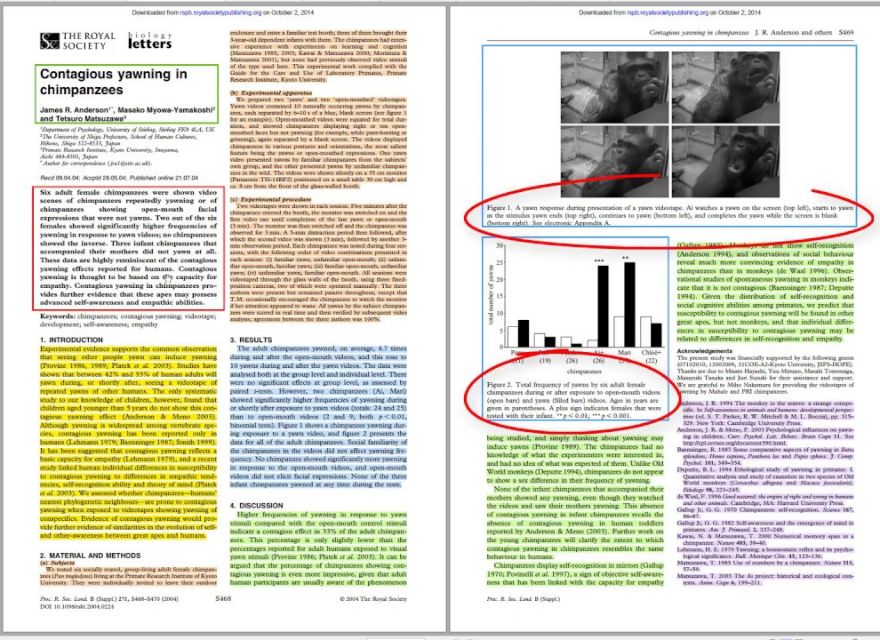
Papers Structure
Scientific papers generally include:
Title
Authors
Abstract
Introduction
Methods
Results
Conclusion.
We focus on the abstract, as it provides a concise summary of the paper's content and is often used for indexing and retrieval.
Notes:
זה הדבר שאמור לגרום לאחרים לעשות לכם swipe כמו בטינדר

Slide 4
Business Point Of View
The problem: 4M+ papers a year – manual abstract tagging is slow, costly, and inconsistent
The need: Automated domain and subdomain classification of papers (and even faster, abstracts)
Customers:
Digital libraries (IEEE, PubMed)
Universities and repositories
Academic publishers and editors
Research teams and recommendation systems
Contribution:
Reduced manual effort
Boost in retrieval accuracy
Enabling large-scale content organization

Slide 5
Data Description
Total Records: 46,985 scientific paper abstracts
Features:
Abstract: Full abstract text of each paper
Domain: Broad research field (e.g., CS, Medical) – 7 distinct values.
area: Specific sub-field or topic - 143 distinct values (we used 130).

Slide 6
Our solutions
Compare three paradigms on identical splits:
1. XGBoost over sparse TF‑IDF vectors (fast, interpretable)
2. Unsupervised LDA topics + classifier (explanatory)
3. Fine‑tuned BERT encoder (state‑of‑the‑art performance)

Slide 7
Goals and Challenges:
Objectives:
Evaluate each model on domain and area classification
Analyze results, interpretability, and resource cost
Challenge addressed
class imbalance
Interpretability
resource trade-off

Slide 8
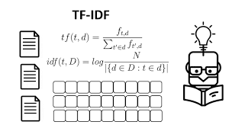
1. XGBoost With TF-IDF
TF-IDF Weights words by rarity across corpus to highlight key terms
XGBoost - Boosted decision trees, sequentially minimizing.
Weight: We applied TF-IDF to all the unigrams and bigrams.
Pros:
+ Easy to deploy as a single pipeline
+ No GPU needed
Cons:
Bag-of-words lacks deep semantic context
Long model training - large TF-IDF + areas

Slide 9
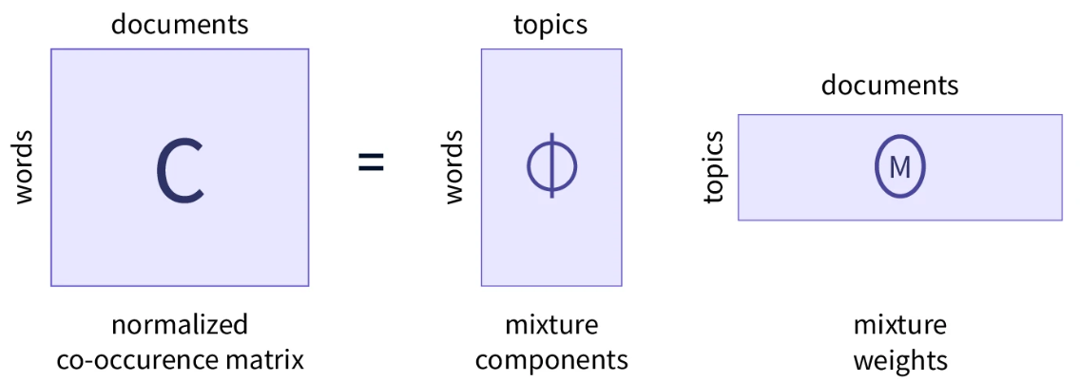
2. LDA - Latent Dirichlet allocation
Probabilistic topic modeling technique
Assumes documents are mixtures of topics
Each topic is a distribution over words.
We Used Gensim package
Pros:
+ Provides interpretable topic structure
+ Good for exploratory analysis
Cons:
- Requires tuning (e.g., number of topics)
- Less accurate for fine-grained classification
Notes:
Use in this project:
Identify latent themes in abstracts
Use topic proportions as features for classification
notebook

Slide 10

3. BERT - Bidirectional Encoder Representations from Transformers
Uses Transformer encoder only
Reads text bidirectionally
Pre-trained on masked language modeling (MLM) and next sentence prediction (NSP)
Suitable for classification only after fine-tuning
Pros:
+ State-of-the-art performance
+ Deep understanding of semantic context
Cons:
- Requires significant computational power
- Results are harder to interpret

Slide 11

3. BERT–base–uncased–MNLI
Based on vanilla BERT (also pre-trained on MLM and NSP)
Fine-tuned on Multi-Genre Natural Language Inference (MNLI)
Has classifier head
Suitable for zero-shot classification tasks and classification fine-tuning
Packages: Transformers, Datasets, Torch

Slide 12
Results - Domain
F1 | Recall | Precision | Accuracy
0.89 | 0.89 | 0.90 | 0.89 | XGBoost With TF-IDF
0.57 | 0.58 | 0.57 | 0.58 | LDA
0.92 | 0.9 | 0.92 | 0.91 | BERT

Slide 13
Results - Area
F1 | Recall | Precision | Accuracy
0.80 | 0.80 | 0.81 | 0.80 | XGBoost With TF-IDF
0.38 | 0.4 | 0.39 | 0.4 | LDA
0.81 | 0.81 | 0.82 | 0.82 | BERT

Slide 14
Conclusions
BERT achieves state-of-the-art results, but at high compute cost.
XGBoost + TF-IDF offers a good balance: doesn’t require GPU, accurate, and explainable, but training time is long.
LDA is useful for interpretability and topic discovery, not for classification.

Slide 15
Limitations
Class imbalance across 143 Area labels; minority recall suffers
Abstract‑only input omits figures, citations, and full‑text context
Transformer models remain less interpretable than tree‑based models

Slide 16
Future Work
Leverage hierarchical label structure via HiBERT
Multiclass labeling
Integrate citation networks and author metadata for richer features

Slide 17
Thank you! Questions?

